Slide 1
C++ Slides - 6
File handling: Formatted I/O, Hierarchy of file stream classes, Opening and closing a file, Working with multiple files, file modes, file pointers, Text vs Binary Files.

Slide 2
Formatting I/O
Set precision
Text justification
Display +/- sign
…

Slide 3
//Formatting example
#include<iostream>
using namespace std;
int main(){
cout<<showpos<<10.1234<<endl; //show +/- sign
cout.precision(4); //total display digits
cout<<-12.34567<<endl;
cout.width(5); // Right justify with 5 char
cout << 'c' <<endl;
}

Slide 4
Output
+10.1234
-12.35
c

Slide 5

Stream
Stream is the flow of digital data (bytes) as input or output through an abstract device (for example screen or files).

Slide 6
File stream classes
ios - all I/O operations
istream is for input e.g. as getline()
ostream is for output e.g. write()
ifstream – Input from file
ofstream – write to a file
fstream – I/O with a file

Slide 7

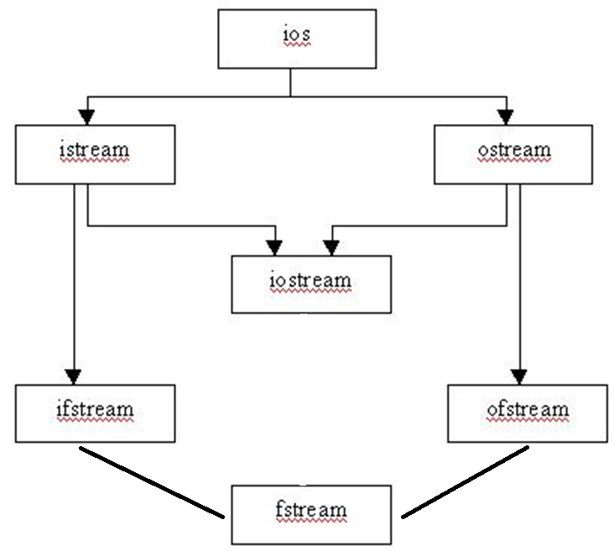

Slide 8
Consider a simple text file MySecrets.txt
This is
a simple text
consisting words
numbers 1234.09872
and symbols !@#$%^&*()

Slide 9
// Read characters from file
#include <iostream>
#include<fstream>
using namespace std;
int main() {
char c;
ifstream fin("MySecrets.txt");
if(!fin) {cout<<"File Does not Exist"; return 0; }
while(!fin.eof()) { // eof – end of the file
fin.get(c); cout<<c; // print text on screen
}
fin.close();}

Slide 10
// Writing text into file
#include <iostream>
#include <fstream>
using namespace std;
int main () {
ofstream file("Simplefile.txt");
file << "Writing to a file in C++....";
file.close();
}

Slide 11
Working with multiple files
// MyFile.cpp
int MyValue() {
return -9999;
}
#include “MyFile.cpp”
#include <iostream>
using namespace std;
int main() {
cout<<MyValue();
}

Slide 12
File modes
ios::app – Always write in the end of a file
ios::ate – Take the control at the end just once
ios::in - Open a file for reading
ios::out - Open a file for writing
ios::trunc – remove the old contents

Slide 13
// Writing text into file using ios::out flag
#include <iostream>
#include <fstream>
using namespace std;
int main () {
fstream file("Simplefile.txt“,ios::out);
file << "Writing to a file in C++....";
file.close();
}

Slide 14
// Reading + writing in a file
#include<iostream>
#include<fstream>
using namespace std;
int main(){
string sen;
ofstream fout(“MySecrets.txt”);
fout<<“hello 123”;
fout.close();
ifstream fin(“MySecrets.txt”);
getline(fin, sen); cout<<sen;
fin.close();
}

Slide 15
Q:Try to read and write a file using ios::in and ios::out
Hint:
fstream fileIO(“MySecrets.txt”,ios::in,ios::out);
You may need file pointers such as seek() and tell() functions which are covered next.

Slide 17
File pointers – bookmarks in the file
Get Pointer tells the current location during file reading
Put Pointer tells the current position during file writing
A file pointer is not like a C++ pointer but works like a book-mark in a book
These pointers help attain random access in file for faster access in comparison to a sequential access

Slide 18
File pointers – seek and tell
Tell function - just examine the file location
Seek function – actually set the bookmark in a file

Slide 19
G and P in – seekg(), tellg(), seekp(), tellp()
G – (as Get) is for file read operation
P – (as Put) is for file write operation

Slide 20
File pointers – seekg(), tellg(), seekp(), tellp()
seekg() and tellg() functions allow you to set and examine the get_pointer in the given file
seekp() and tellp() functions perform these operations on the put_pointer.

Slide 21
Current, beginning and & end
References for seek and tell functions
ios::beg
ios:cur
ios:end

Slide 22
Few examples
fin.seekg(30); or fin.seekg(30, ios::beg);
// go to byte no. 30 from beginning of file
fin.seekg(-2, ios::cur); // back up 2 bytes from the current position of get pointer
fin.seekg(-4, ios::end); // backup 4 bytes from the end of the file

Slide 23
Text vs Binary Files
In text files various character translations are performed such as “\r+\f” is converted into “\n”, whereas in binary files no such translations are performed.
By default, C++ opens the files in text mode.

Slide 24
Text files versus Binary files
ofstream out (“myfile.txt”);
Storage is more e.g. floating point numbers (IEEE 754) 12345.1234 will take 10 char bytes.
Access is slower using sequential search
ofstream out (“myfile.txt”,ios::binary);
Memory efficient for storage.
Each binary file maintains a header of content index for faster search as compared to text files. More info is required but access is faster.

Slide 25
Useful codes for file programs
// how to count characters in a file
int count = 0; char ch; while(!fin.eof()) { fin.get(ch); count++; }
// how to count words in a file
int count = 0; char word[30]; while(!fin.eof()) { fin >> word; count++; }
// how to count lines in a file
int count = 0; char str[80];
while(!fin.eof()) { fin.getline(str,80); count++; }

Slide 26
// Copy contents of one file into another
#include<iostream>
#include<fstream>
using namespace std;
int main() {
char ch;
ifstream fin("MySecrets.txt");
ofstream fout("CopyMySecrets.txt");
while(!fin.eof()) {
fin.get(ch);
fout << ch;
}
fin.close(); fout.close();
}

